Slide 1


WELCOME
TO THE CLASS OF
Senior
2026
Meeting
Brought to you by Senior Class ASB

Slide 2

Senior Year
Expectations
MR. TOWER

Slide 3
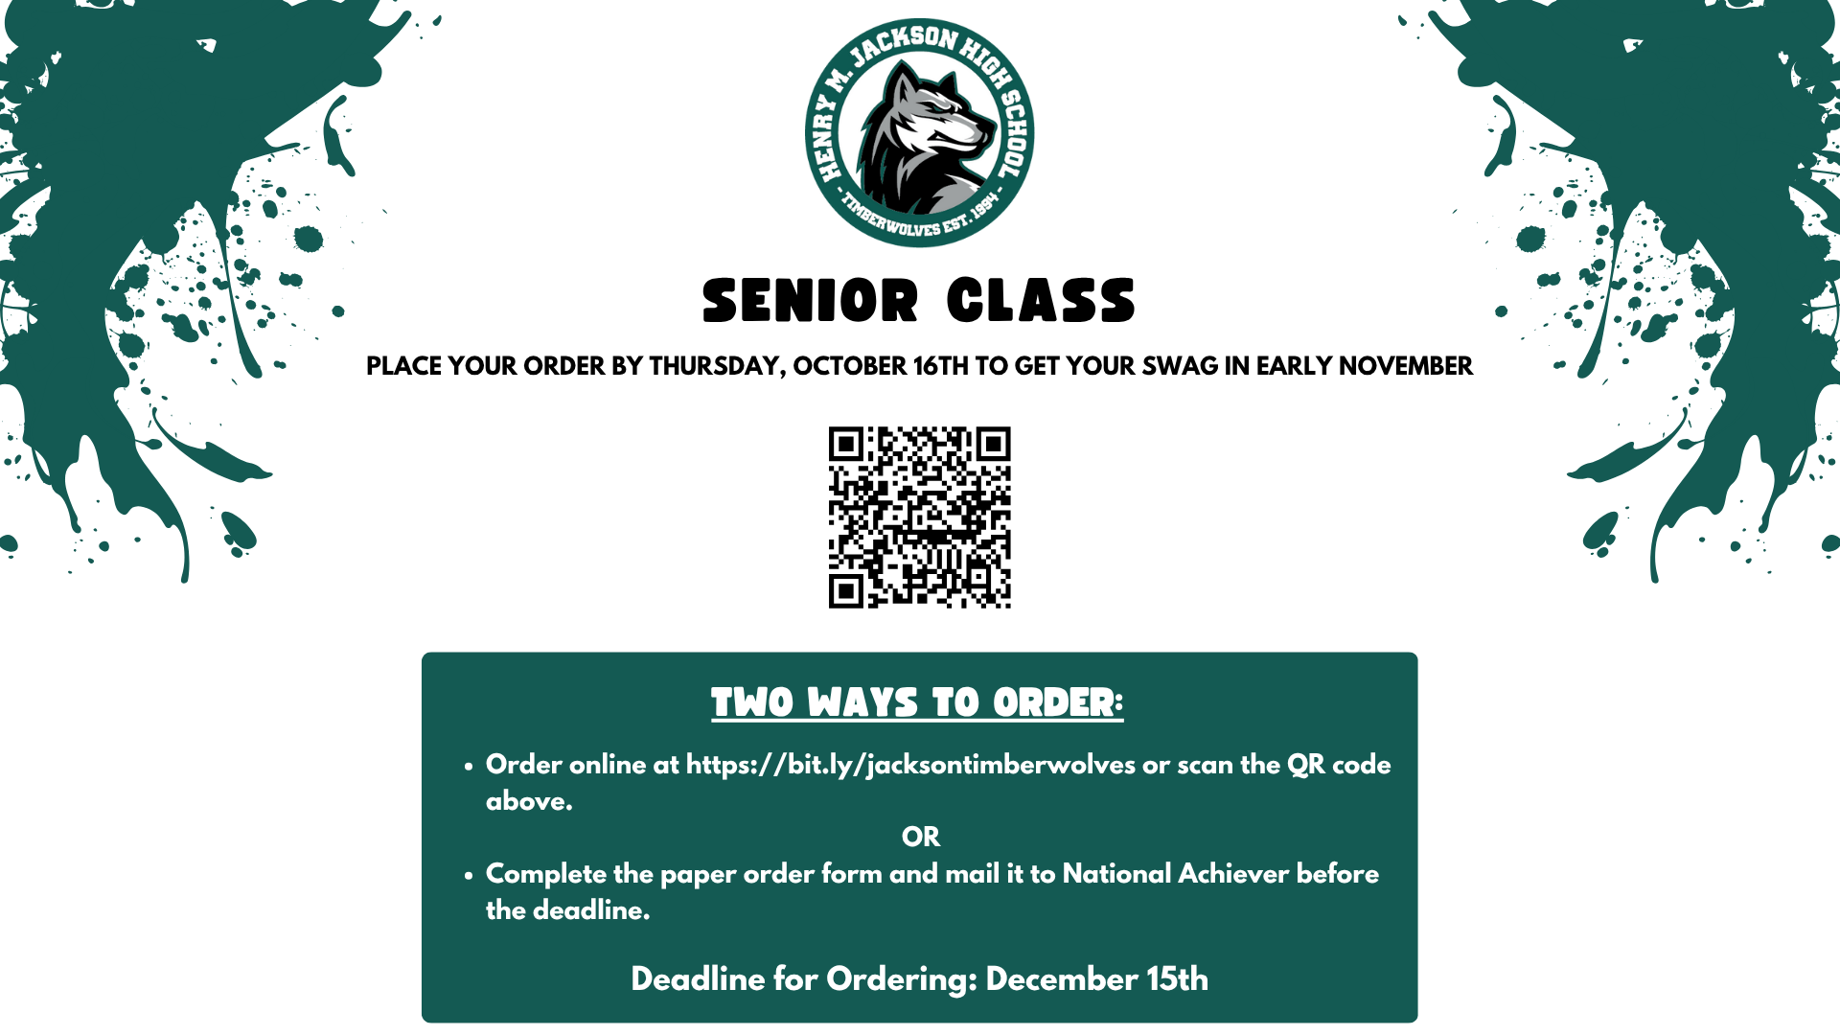
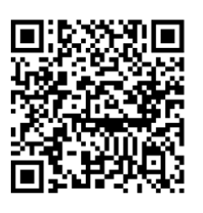

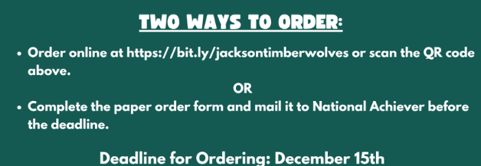
CAPS & GOWNS

Slide 4
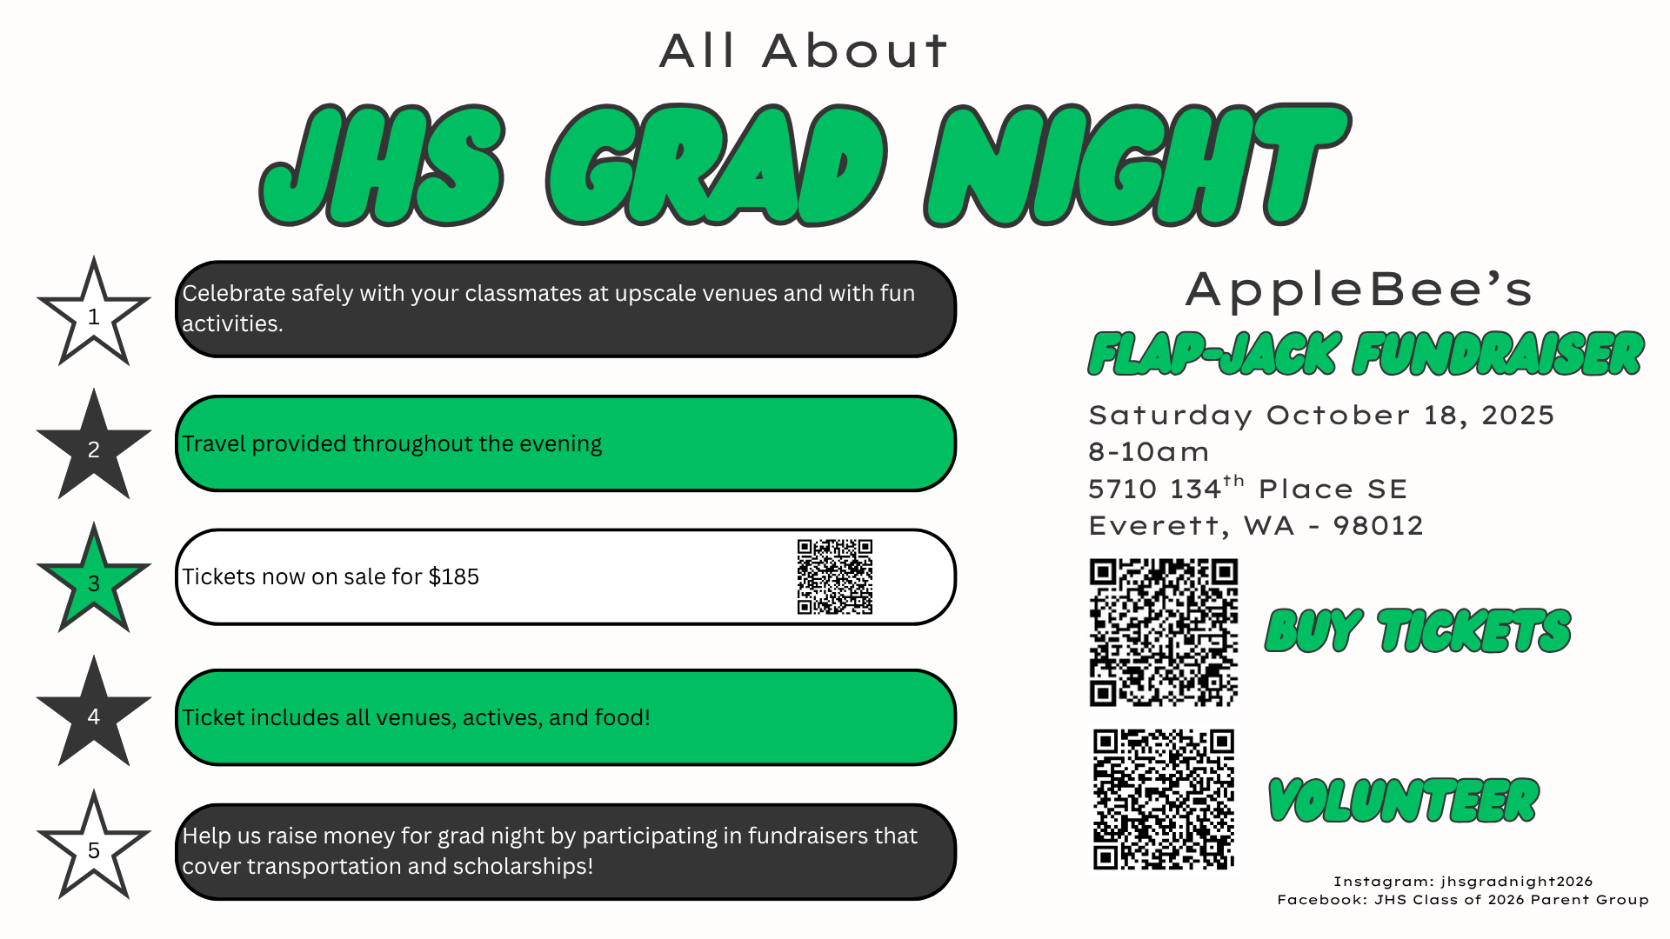

Slide 5

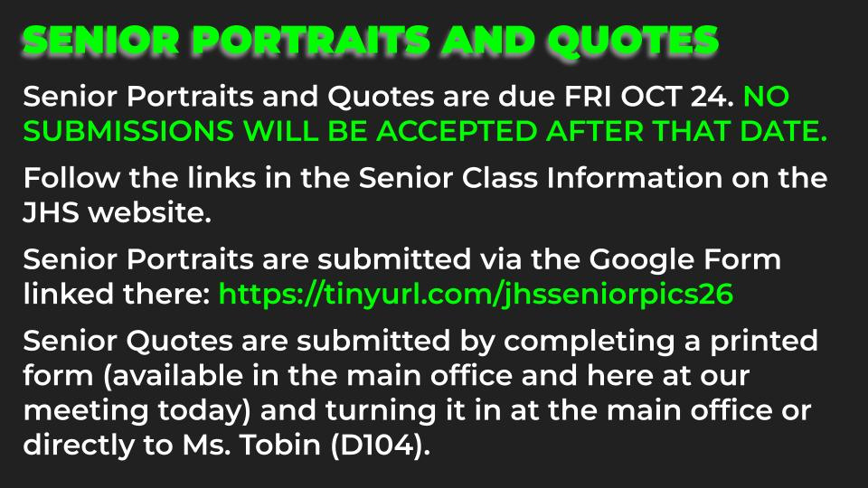

PORTRAIT CHECKLIST
Senior Portraits
Yearbook
Jpg file of at least
1,000 pixels per slide
Headshot in vertical (portrait) orientation
Standard RATIO of
2'’W x 3'’H
Clearly identifiable
SENIOR PORTRAIT & QUOTE INFORMATION:
DUE DATE: Friday, 10/24/25
PORTRAIT: Submit digitally into https://tinyurl.com/jhsseniorpics26
QUOTE: In person in the JHS main office
3'’
QUOTE
2'’

Slide 6
High School and Beyond Night
Financial Aid Help Night
College & Career Fair (in the Gym):
October 15th, 2025
5:30 - 7PM
Session 1: 6:30 - 7:10 PM
Session 2: 7:15 - 7:55 PM
Where? JHS upstairs classrooms,
Library & Commons
What? Visit representatives at the Career & College Fair, and attend 2 breakout sessions that support your post-HS goals
Financial Aid Help Night: October 29
Wednesday, 6-8pm,
Annex area at JHS
Receive help with completing the FAFSA/WASFA financial aid applications receive help completing FAFSA & WASFA financial aid applications. Interpreters available.

Slide 7
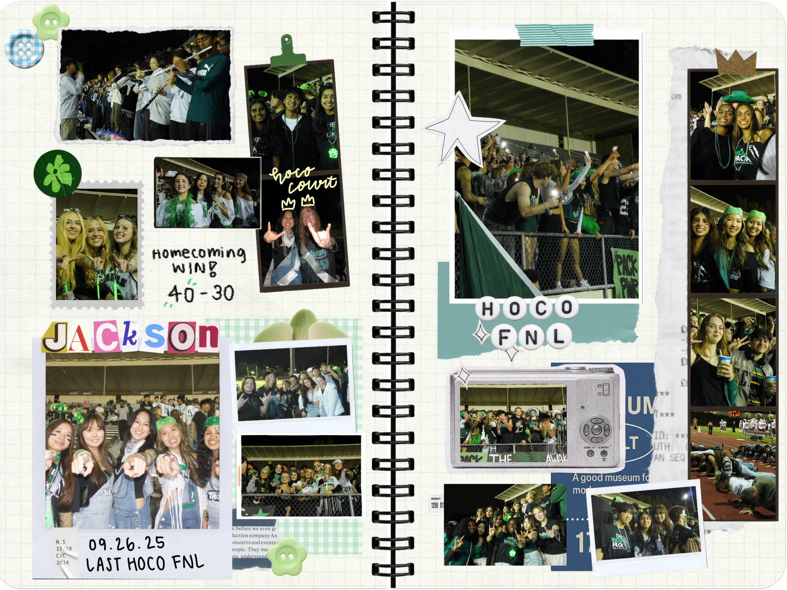
SENIOR SCRAPBOOK
@jhs26.mp4
Send photos to:
jhsasb.2026@gmail.com
@jhs26.mp4
@jhsasb.2026
@christinehyoh
Notes:
Christine
Pre-post Christine's post
AFTER meeting, post Jolie's video

Slide 8


prom theme
Voting
Notes:
Christine
Pre-post Christine's post
AFTER meeting, post Jolie's video
After slide 8
Christine passes the mic to Hannah
Hannah describes the venue a little bit
- Then introduces 4 themes, describes them, reads the names
- Then pass the mic to Ellen, and Ellen talks about the date, time, and QR Code
- Then Ellen passes the mic to Hannah, and Hannah reads off slide 14
- Then Hannah passes off to Alaina

Slide 9


Slide 10


Slide 11


Slide 12


Slide 13

The quality of prom (decorations, catering, etc.) depends on your participation for fundraisers! Please make sure to support the 2026 ASB!

Slide 14


MOD PIZZA
fundraiser
TODAY ALL DAY!
All funds will go into prom!

Slide 15
Senior
Movie Night
There will be
an Instagram poll for movie recommendations and voting near the date!
December 05, 2025
6-9 PM
Notes:
We also have an upcoming class event, senior movie night. We wanted to implement a time where we could all relax from our exams and college apps, so we thought we could watch a movie all together. You guys can bring blankets and stuffed animals, and we're hoping to have some hot cocoa and maybe some popcorn. As we approach the date, we will upload a voting poll for which movie we should watch. So make sure you mark your calendars for December 5th, which is a Friday, from 6-9 PM.

Slide 16
Thank you
CONTACT INFO:
jhsasb.2026@gmail.com
INSTA:
@jhsasb.2026
@jhs26.mp4
Notes:
Keep students until bell rings

